Slide 1


Fortis: A Tool for Analysis and Repair of Robust Software Systems
Changjian Zhang¹, Ian Dardik¹, Rômulo Meira-Góes², David Garlan¹, Eunsuk Kang¹
^{1.} Carnegie Mellon University
^{2.} The Pennsylvania State University

Slide 2



Motivation: Robust-by-Design
Methodologies to systematically and rigorously analyze, measure, and improve system robustness.
Design
Robustness
Analysis
Methods to systematically measure robustness.
Developer, Designer,
Architect
Methods to systematically improve the robustness of a system design.
Robustify
Design
Notes:
Fortis is a toolbox for robustness. Our goal is to …
Especially, we focus on formal reasoning of robustness.
In particular, we are promoting this robust-by-design dev process where…

Slide 3
Contributions of Fortis
A toolbox for robustness analysis:
Provide analysis for robustness measurement.
Provide support for automatic robustification.
An extensible framework for future robustness analysis and robustification methods.
Design
Robustness
Analysis
Developer, Designer,
Architect
Robustify
Design
Notes:
So in Fortis, we provide a method to systematically compute software robustness. Then, it also provides a method to automatically robustify a system.
We also aim to make Fortis an extensible framework for future robustness analysis and robustification methods.

Slide 4
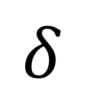
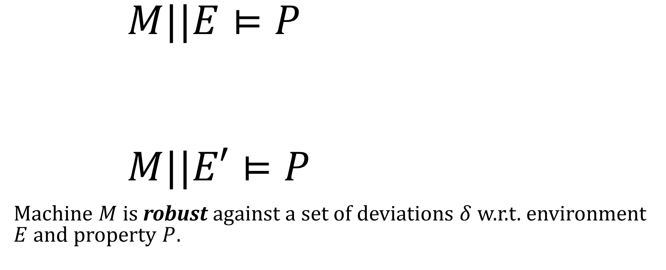
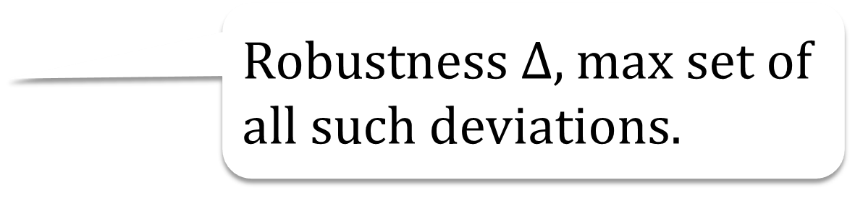
Formal Definition of Robustness
Labeled transition systems
$M||E⊨P$
$M||E′⊨P$
Machine $M$ is robust against a set of deviations $δ$ w.r.t. environment $E$ and property $P$.
A set of traces
Robustness $Δ$, max set of all such deviations.
$$δ$$

Slide 5
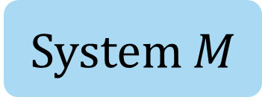
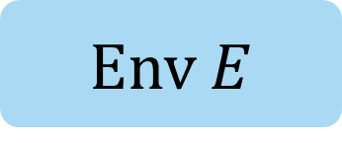
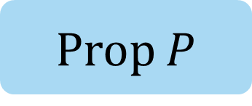
Model Checking
Env $E$
Yes!
Model Checking
System $M$
No!
Prop $P$

Slide 6
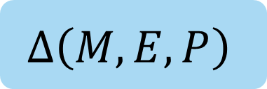
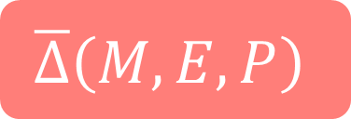
Fortis: Robustness Analysis
Robustness
Env $E$
$$Δ\left(M,E,P\right)$$
Robustness Analysis
System $M$
$$\overline{Δ}\left(M,E,P\right)$$
Fortis
Prop $P$
Intolerable Deviations

Slide 7
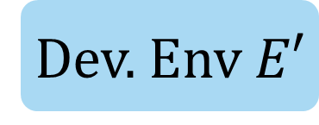
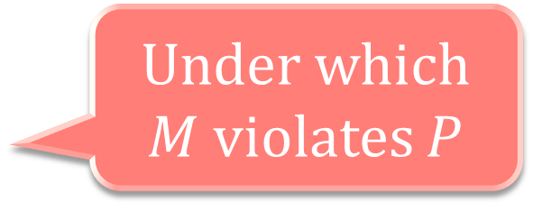
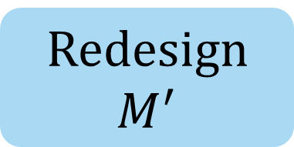
Fortis: Robustification
Under which $M$ violates $P$
A more robust design
Dev. Env $E′$
Robustification
Redesign $M^{′}$
System $M$
Fortis
Prop $P$

Slide 8
Example: Therac-25
Notes:
I’ll use the infamous Therac-25 therapy machine as an example to briefly walk through the capability of Fortis.

Slide 9
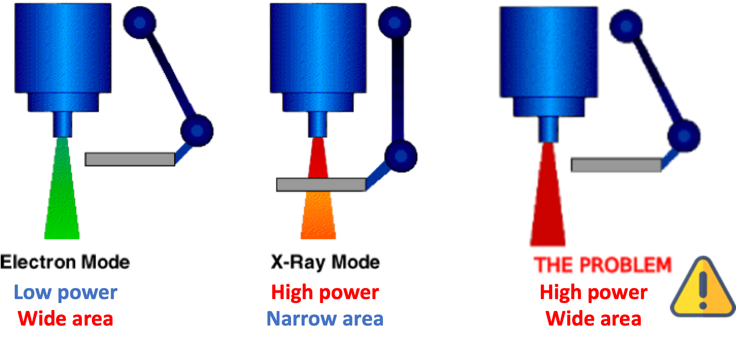
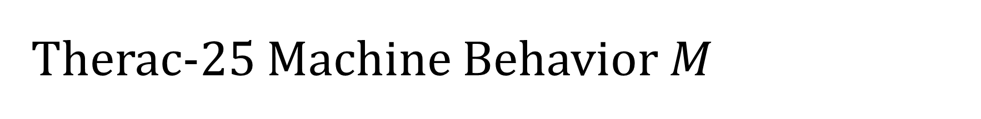
Therac-25 Machine Behavior $M$
Electron (EBeam) and X-Ray modes.
A spreader in place during X-Ray for safe radiation level.
Notes:
Therac-25 is a machine for radiation therapy. We first consider its machine behavior.
It has two radiation modes, Electron beam mode and X-ray mode.
Electron beam mode has low power but for wide area.
The X-ray mode has high power but for narrow area.
When the user chooses X-ray mode, A spreader would be in place to ensure safe radiation level.

Slide 10

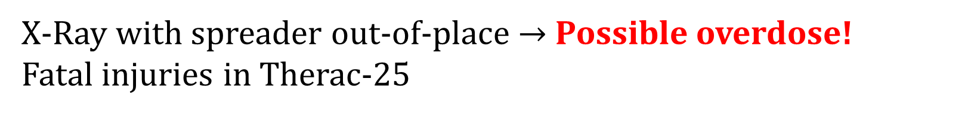
Safety Requirement $P$
X-Ray with spreader out-of-place $→$ Possible overdose!
Fatal injuries in Therac-25
Notes:
Therefore, we can consider a safety property of it, i.e., the spreader should always be in place to avoid potential overdose of Xray.
Otherwise, the overdose may cause fatal injuries of patients.
Unfortunately, this overdose happened and caused several deaths.

Slide 11
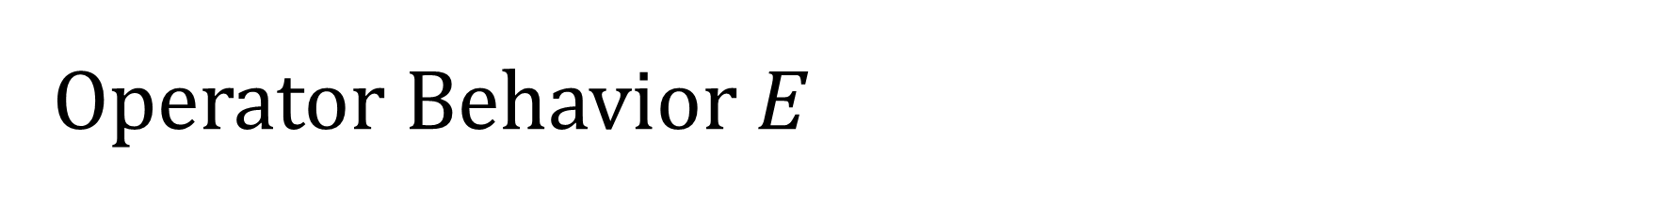
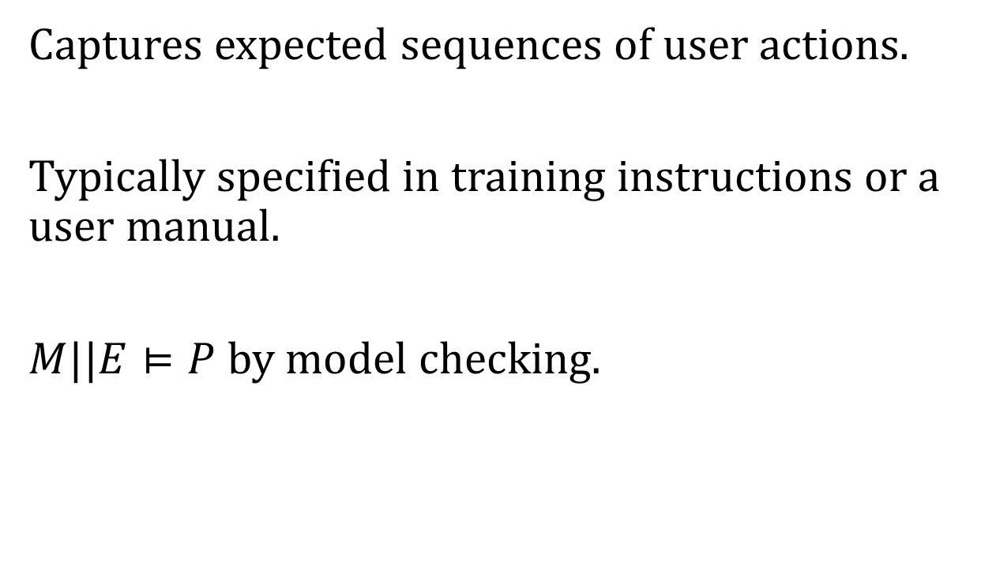
Operator Behavior $E$
Select Mode
Captures expected sequences of user actions.
Typically specified in training instructions or a user manual.
$M||E⊨P$ by model checking.
X
E
Confirm Mode
Enter
Fire Beam
B
Task Complete
Notes:
In order to understand why the safety violation may occur, we should also consider the operator’s behavior, i.e., the environment model.
The normative env model captures …
And by running model checking, we can tell that the system is safe.

Slide 12

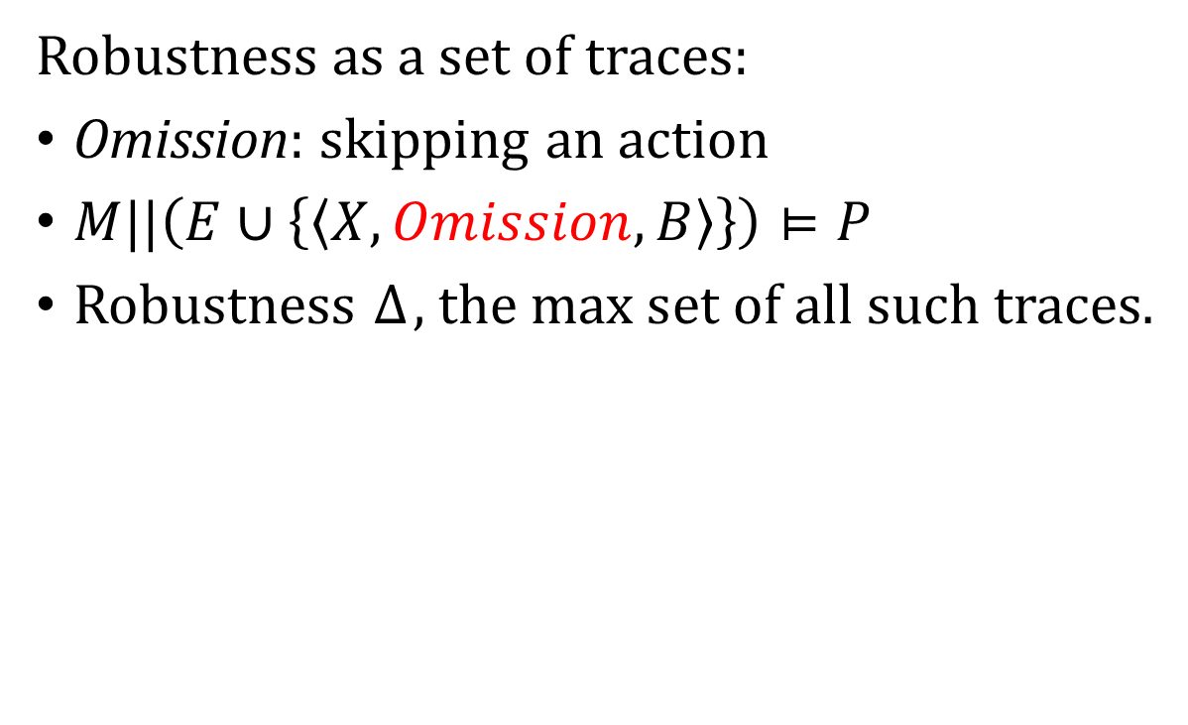
Robustness $Δ$
Select Mode
Robustness as a set of traces:
Omission: skipping an action
$M||\left(E∪\left\{\left\langle X,Omission,B\right\rangle \right\}\right)⊨P$
Robustness $Δ$, the max set of all such traces.
X
E
Confirm Mode
Omission
Enter
Fire Beam
B
Task Complete
Notes:
However, what about robustness? Can we say something about robustness by given these models.
So in our FSE20 paper, we first try to model uncertainties of the environment or in other words, deviations of the environment.
In our case, deviations are traces … And a system is robust against it, when … Finally, robustness is captured by the max
For example, we can consider a deviation of an omission error.
Omission means the user forgot to perform certain actions. In this case, the user could forgot to press enter but fire the beam.
By model checking, we can also tell that the machine is safe under such a deviation. So it is robust against it.
And we present a method to compute all such traces.

Slide 13

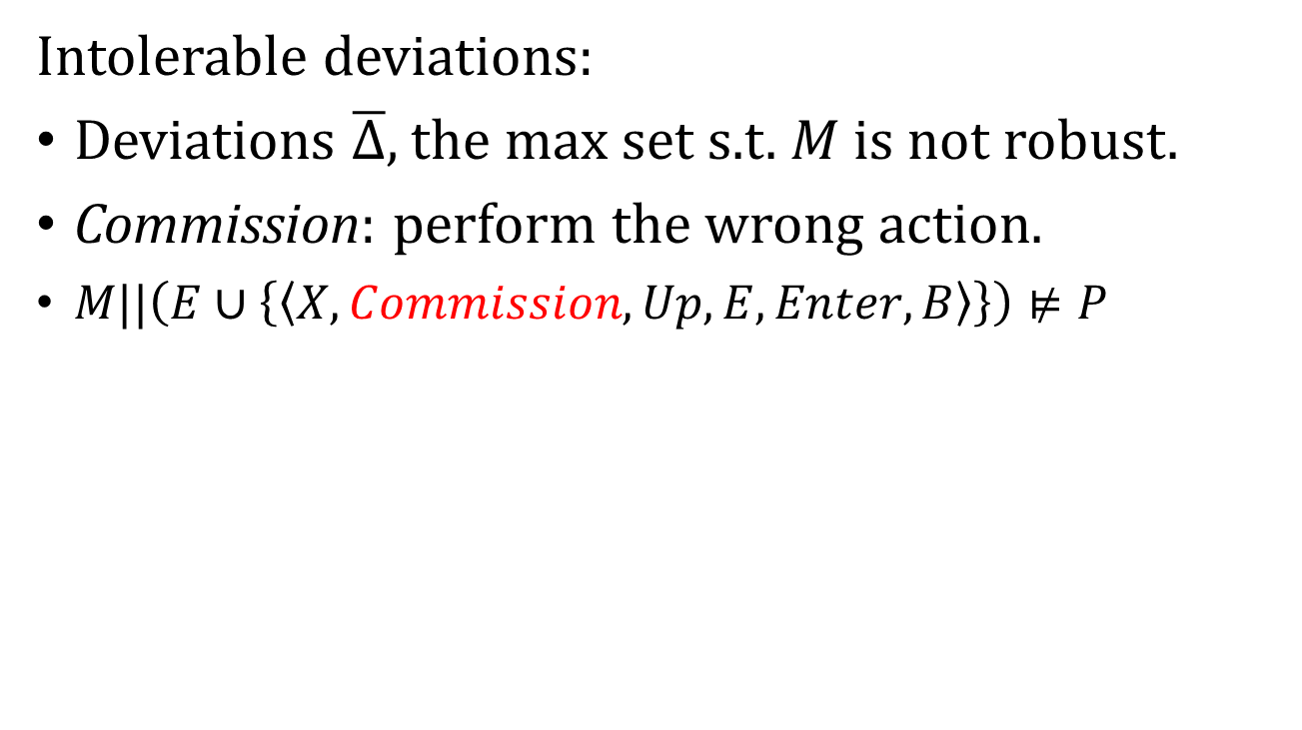
Intolerable Deviations $\overline{Δ}$
Select Mode
Intolerable deviations:
Deviations $\overline{Δ}$, the max set s.t. $M$ is not robust.
Commission: perform the wrong action.
$M||\left(E∪\left\{\left\langle X,Commission,Up,E,Enter,B\right\rangle \right\}\right)⊭P$
Up
Go Back
X
E
Confirm Mode
Commission
Enter
Safety violation!
Fire Beam
B
Task Complete
Notes:
On the other hand, the user might be interested in all the traces that the machine is not robust against. We call them intolerable deviations.
For example, another type of human error is commission error, i.e., the user performs the wrong action.
In this case, the user may accidentally choose the wrong mode and use up to change the beam mode.
However, this could cause a safety violation.
In particular, if the user first chose X-ray, and then changes to Electron beam mode. The spreader is out of place after selecting Electron beam, but when the user press B to fire the beam, it may still in the transition from X-ray to Ebeam which causes a safety violation.
And by using fortis, we can also find all such intolerable deviations.

Slide 14
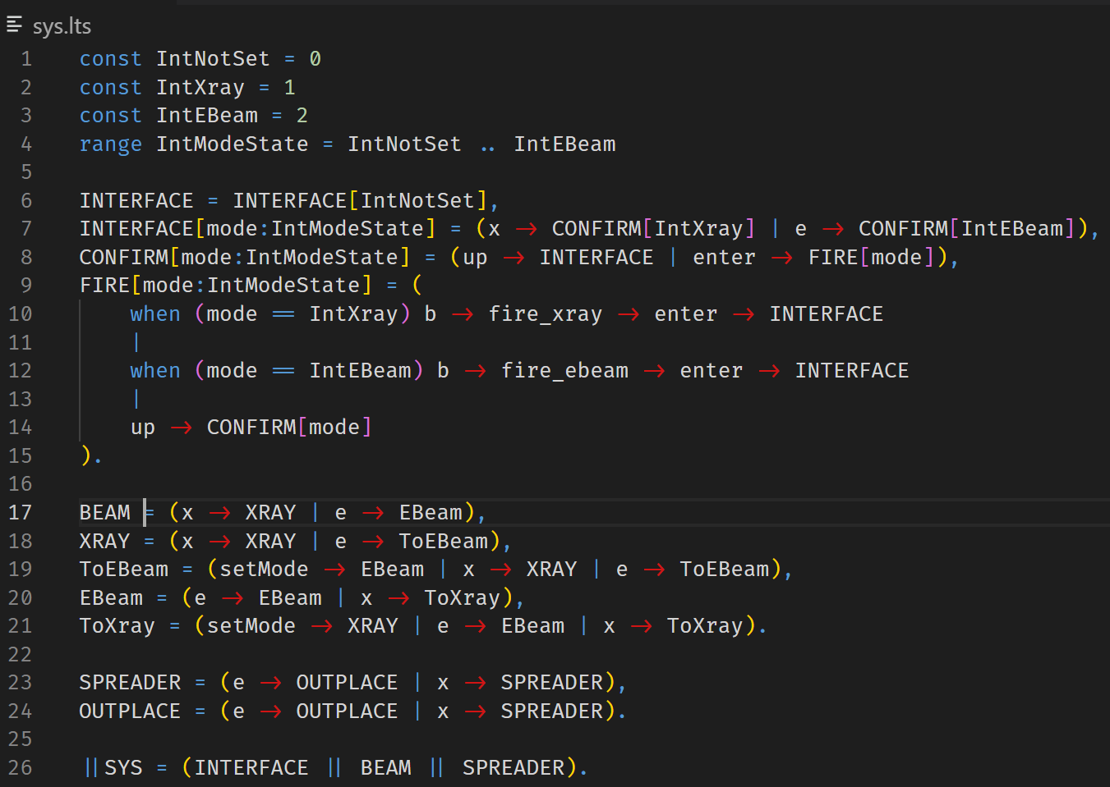

Slide 15
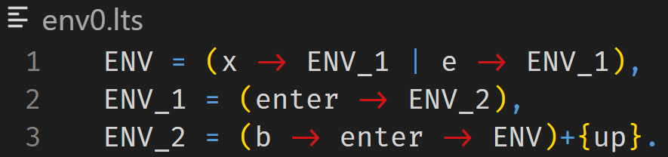

Slide 16
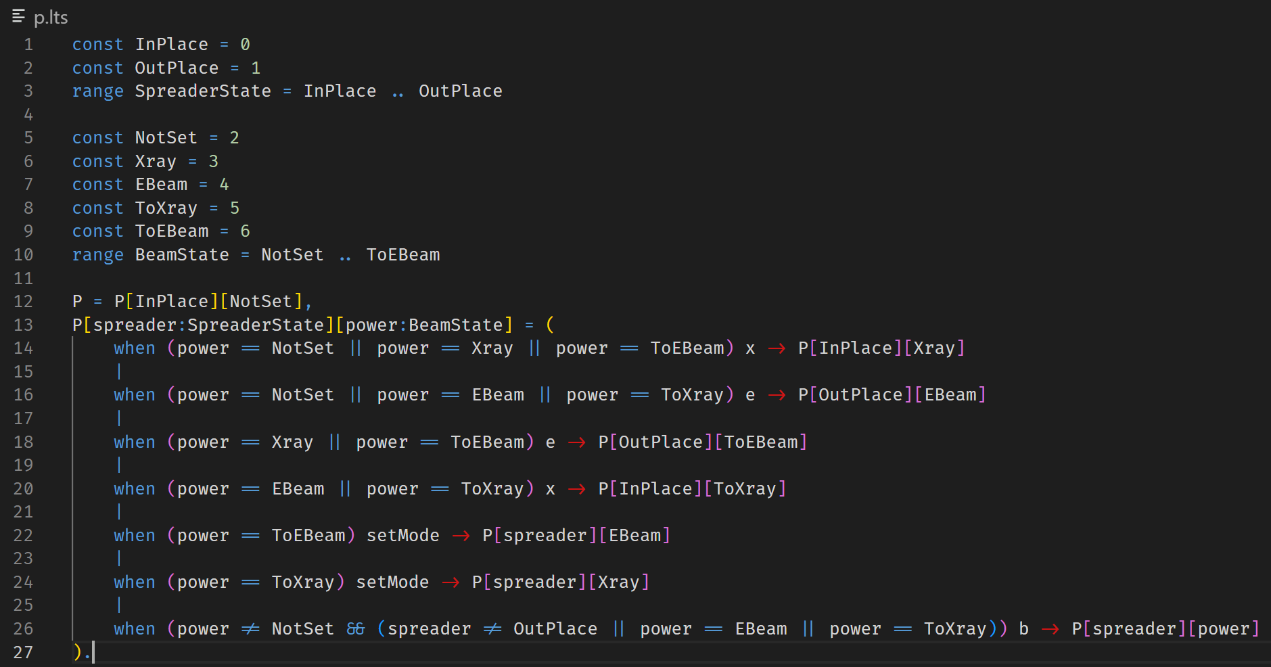

Slide 17
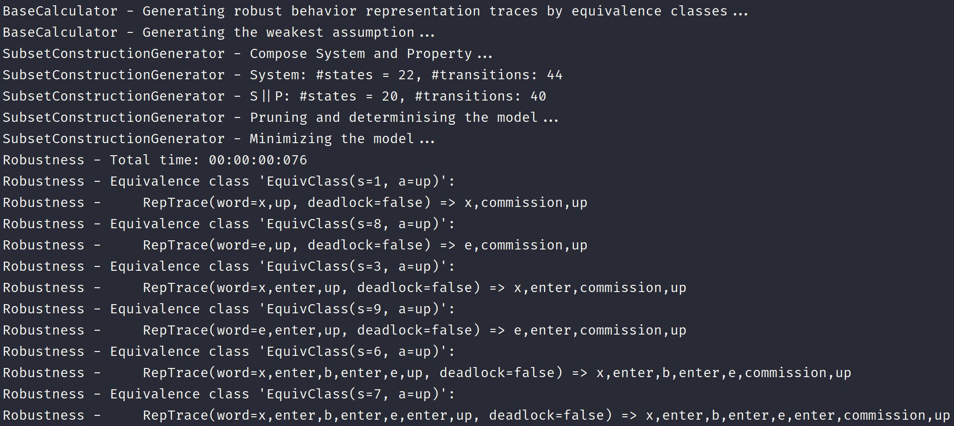

Slide 18
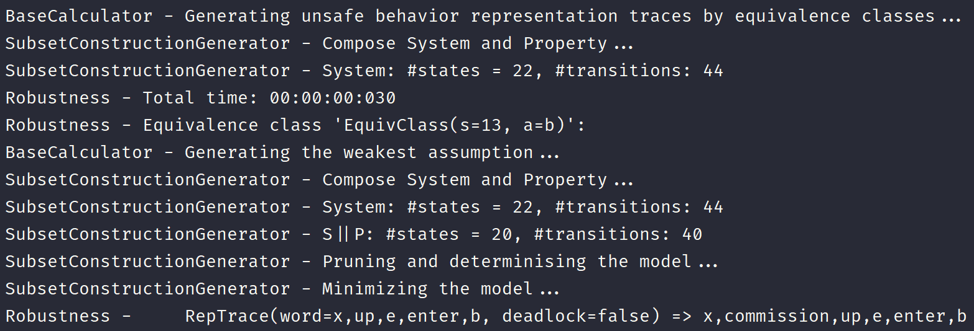

Slide 19
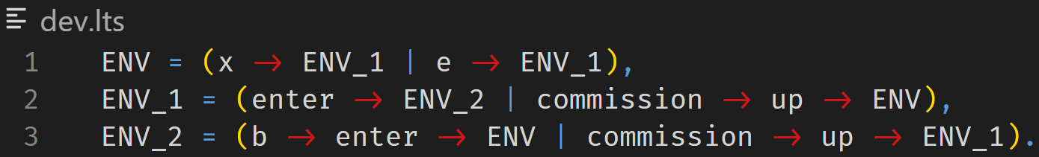

Slide 20
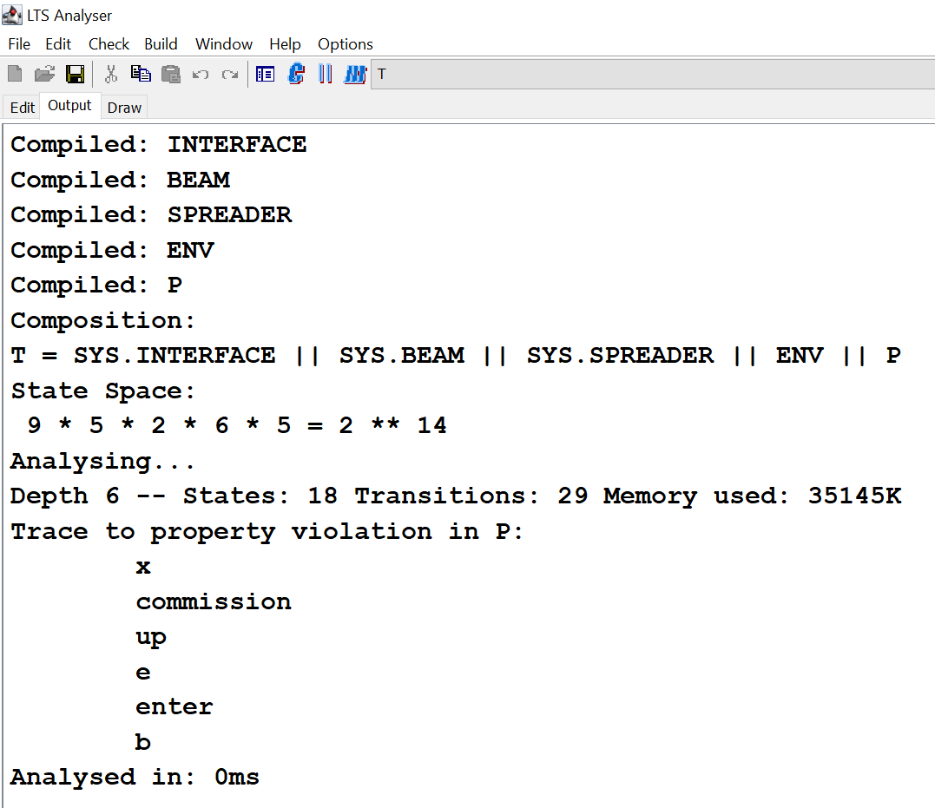

Slide 21
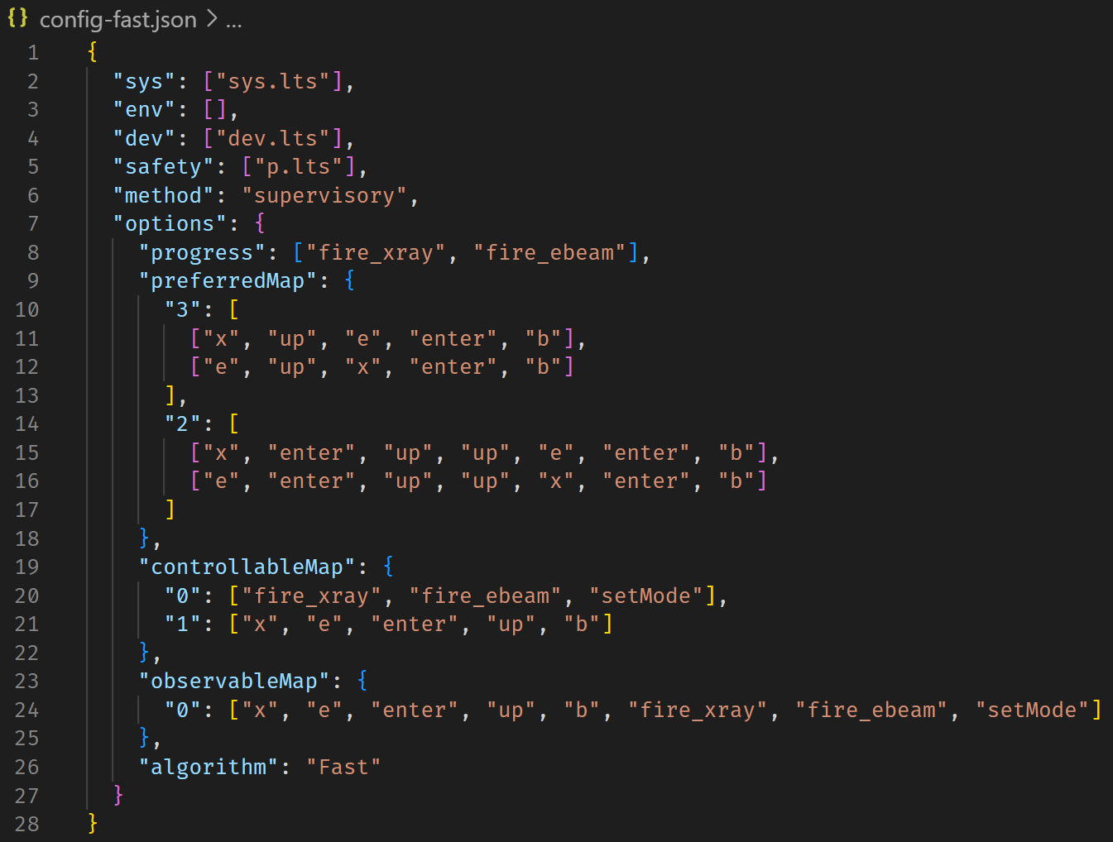

Slide 22
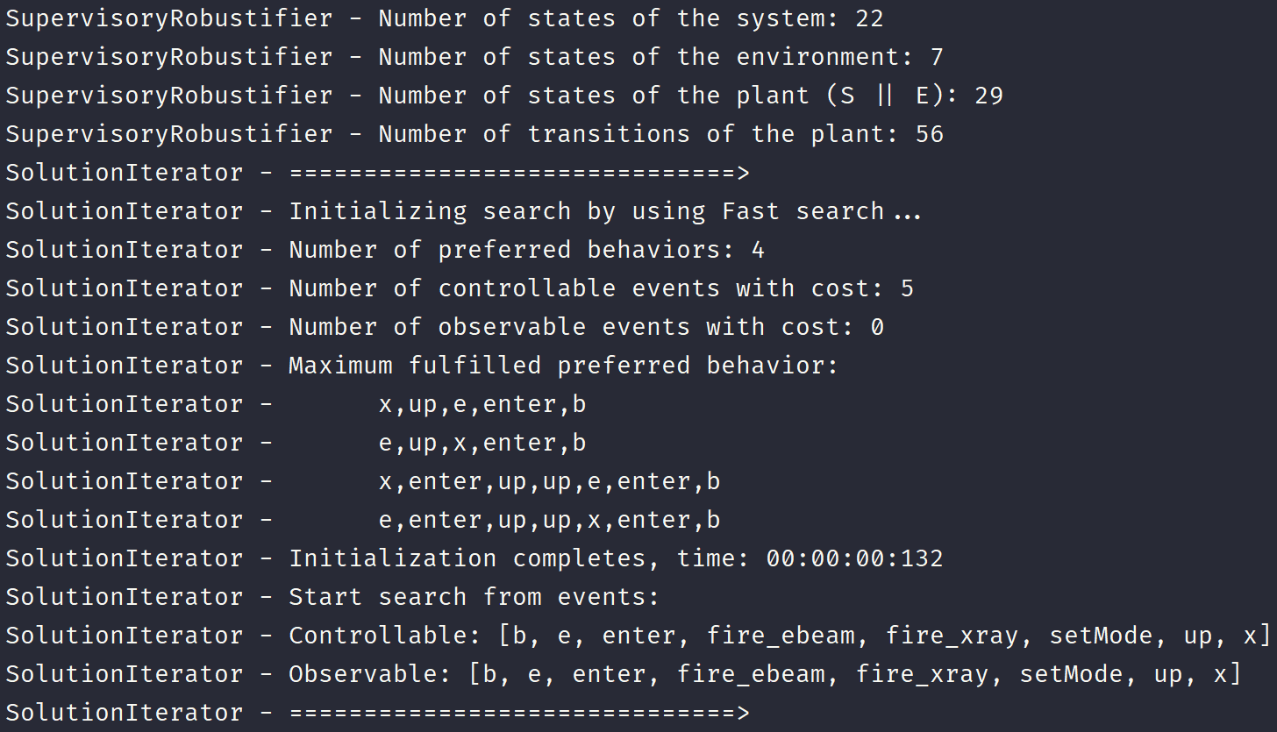

Slide 23
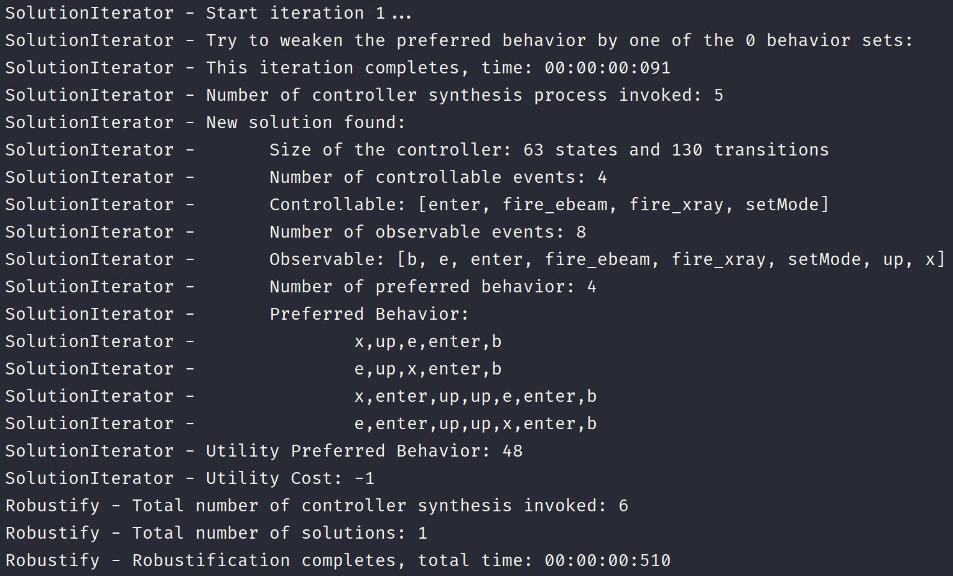

Slide 24
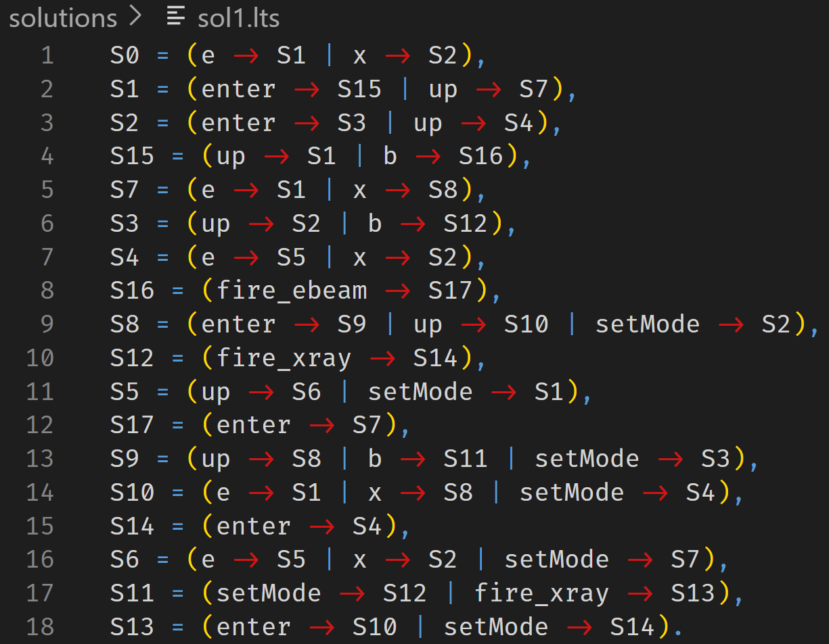

Slide 25
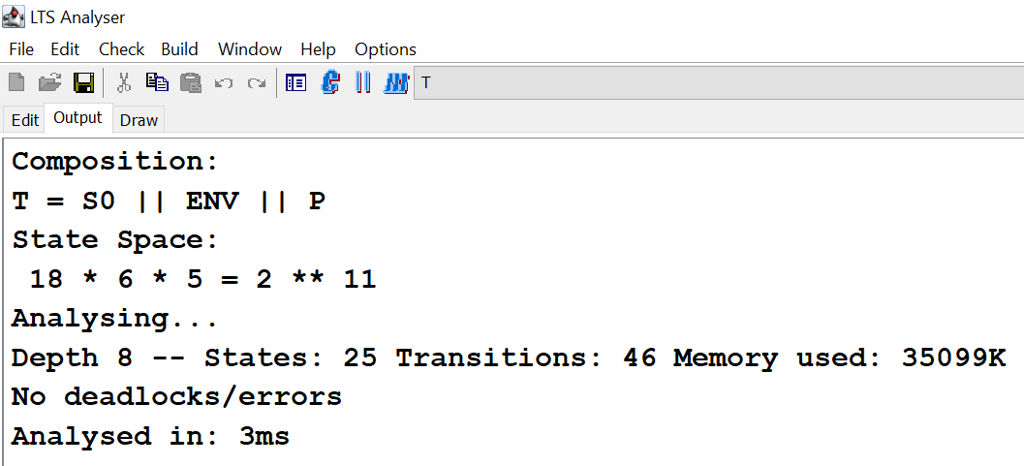

Slide 26
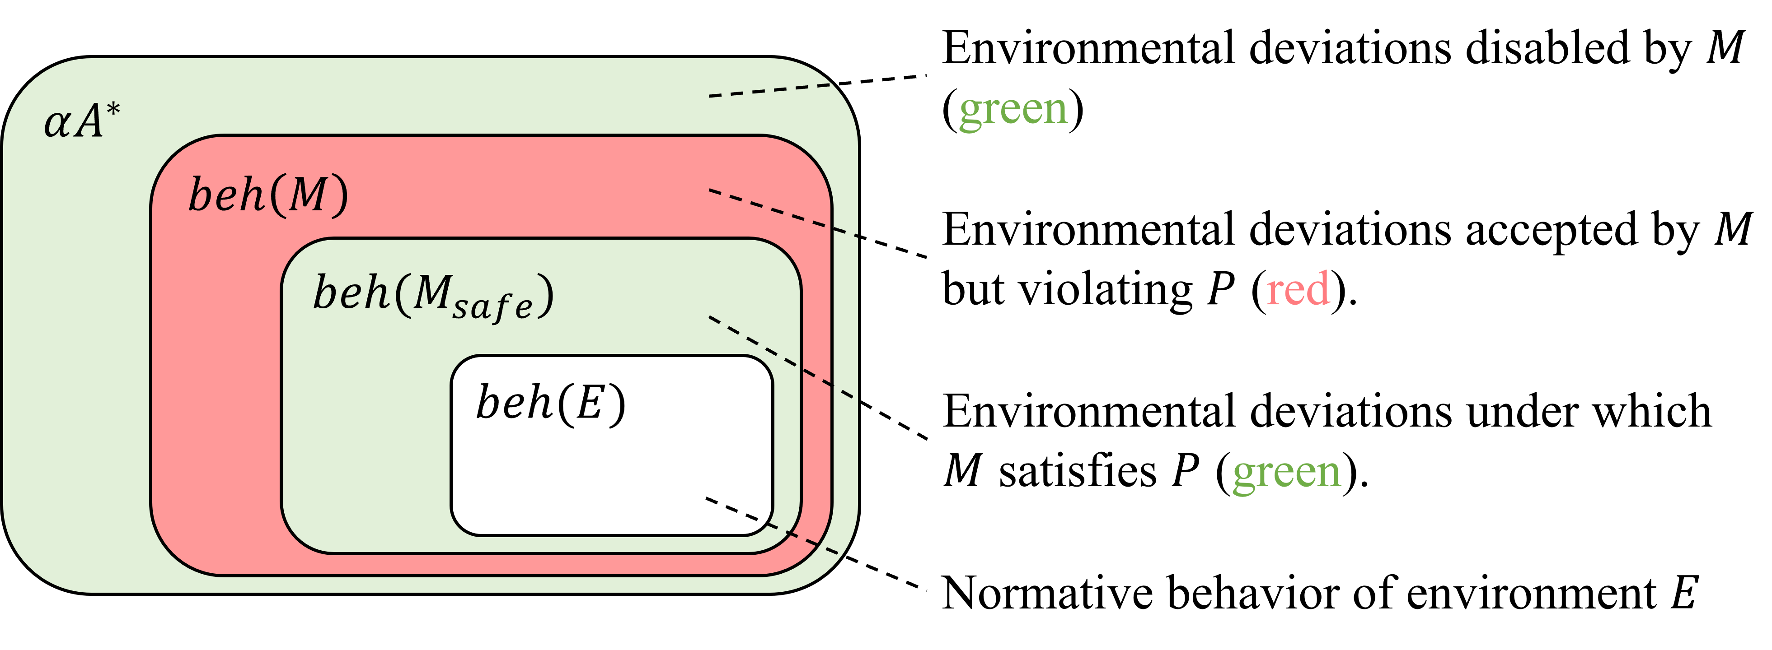
Robustness Computation
A behavioral notion of robustness for software systems. Changjian Zhang, David Garlan, and Eunsuk Kang. (FSE 2020)

Slide 27
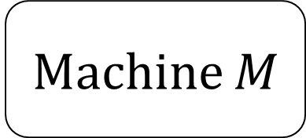
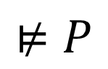
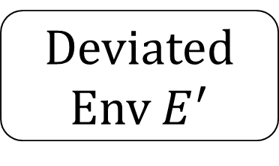
Robustification by Supervisory Control
Consider the problem as a control problem.
Machine $M$
Deviated Env $E^{′}$
$$⊭P$$
Notes:
The idea of it is to consider the problem as a control theory problem. Where the machine and the environment forms a system need to be controlled to satisfy the property.

Slide 28
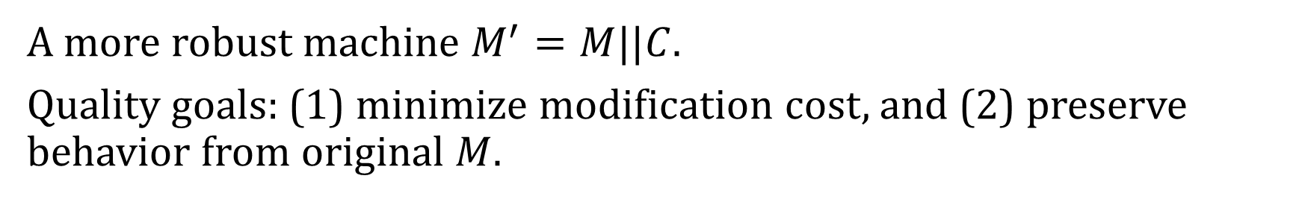
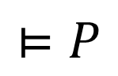
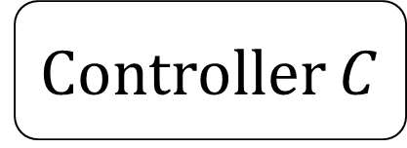
Robustification by Supervisory Control
Controller $C$
Ensure property is satisfied by disabling actions.
Observe events in the machine and environment.
$$⊨P$$
Machine $M$
Deviated Env $E^{′}$
A more robust machine $M^{′}=M||C$.
Quality goals: (1) minimize modification cost, and (2) preserve behavior from original $M$.
Robustification of Behavioral Designs against Environmental Deviations. Changjian Zhang, Tarang Saluja, Romulo Meira Goes, Matthew Bolton, David Garlan, and Eunsuk Kang. (ICSE 2023).
Notes:
Then, we can synthesize a controller C to make the system satisfy the property.
The controller can observe the events in the machine and the environment, and it ensure the safety property by disabling actions.
Of course, if we disable all the actions, the system should be considered safe, but apparently that’s not what we want.
So to avoid such useless solution, we introduce two quality goals of the solutions:
One is to minimize the cost of modification of the new design.
Second is to preserve as much behavior as possible from the original machine.
More details can be found in our ICSE paper.

Slide 29
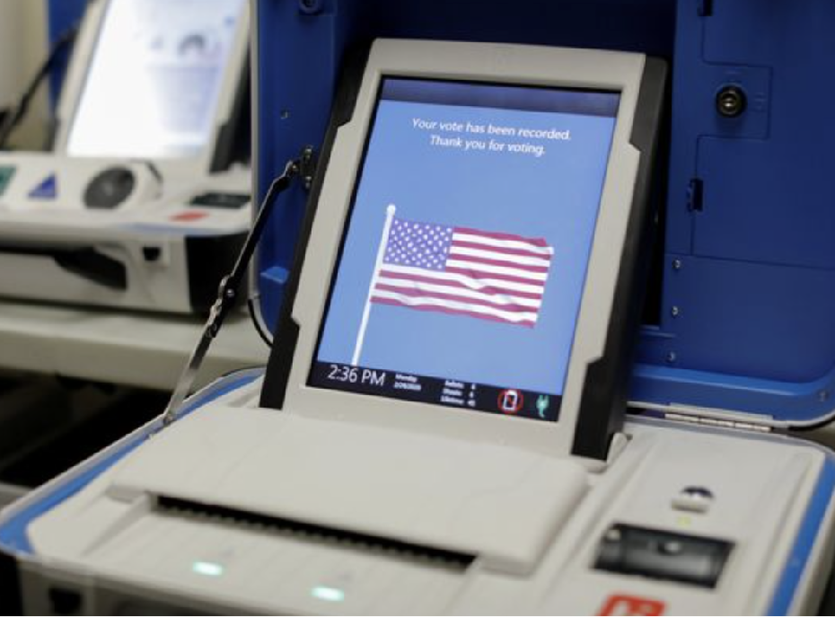
Benchmark
Therac-25 radiation machine
ABP protocol
iVotronic voting machine
Oyster public transportation system
Infusion pump

Slide 30
Future Development Plan
Other robustness analysis methods
Support for liveness properties.
New synthesis methods for robustification.
Integrating these methods to TLA+.
Extend robustness analysis to CPS and ML.
Visualization for models, robustness, and repair.
Explainability.

Slide 31

Try out Fortis!
GitHub: https://github.com/cmu-soda/Fortis
Our Robustness Works:
A behavioral notion of robustness for software systems. (FSE20)
Robustification of Behavioral Designs against Environmental Deviations. (ICSE23)
Safe Environmental Envelopes of Discrete Systems. (CAV23)
Design
Robustness
Analysis
Developer, Designer,
Architect
Interested?! Find more in our paper and GitHub!
Robustify
Design

Slide 32
Implementation of Fortis
Implemented in Java and Kotlin.
Automatalib to store and manipulate LTS
Supremica as the controller synthesizer.
Support AUT, FSM, and FSP (language of the LTSA) modeling languages.
A command line interface is provided.

